Slide 1

HEALTHCARE PROVIDER FRAUD
MD FAKHRUL ISLAM
DATA SCIENTIST

Slide 2
01
BUSINESS PROBLEM
02
DATA PROCESS
03
DELIVERY
04
NEXT STEPS & SUMMARY
AGENDA

Slide 3
01
DATA SCIENTIST, INSTITUTE OF DATA
02
03
MASTER OF BIO STATISTICS, USYD
04
MASTER OF INFORMATION SYSTEMS, CQU
MASTER OF SCIENCE IN STATISTICS, DU
BIO
BIO STATISTICIAN, UNSW
05

Slide 4
01
$2.7T, 17% of GDP in Australia
02
03
PROBLEM OVERVIEW
$455B – global healthcare lost/annum
Australia – growing @ 7%, Only a 3rd of losses - detected

Slide 5
BUSINESS QUESTION
”Given the current low levels of loss detection, can we use Machine Learning to increase loss detection and prevent fraud?”

Slide 6
DATA QUESTION
”Using Provider claim history, can you accurately predict Fraud?”
Data Source: Kaggle

Slide 7

STAKEHOLDER
Steve Dunlop
Director, Primary Care Reviews, Medicare Reviews Unit
Australian Government Department of Health

Slide 8
01
BUSINESS PROBLEM
02
DATA PROCESS
03
DELIVERY
04
NEXT STEPS & SUMMARY
AGENDA

Slide 9
PROCESS FLOW
FEATURE ENGINEERING
TRAINING MODEL
EDA
FEATURE SELECTION
EVALUATION & TESTING

Slide 10
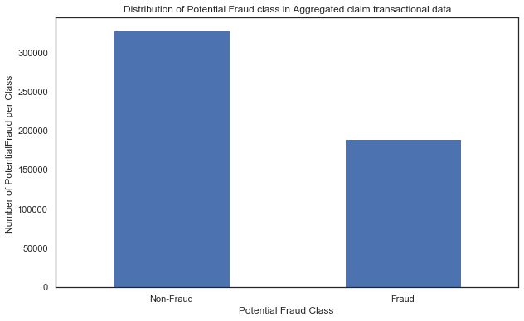
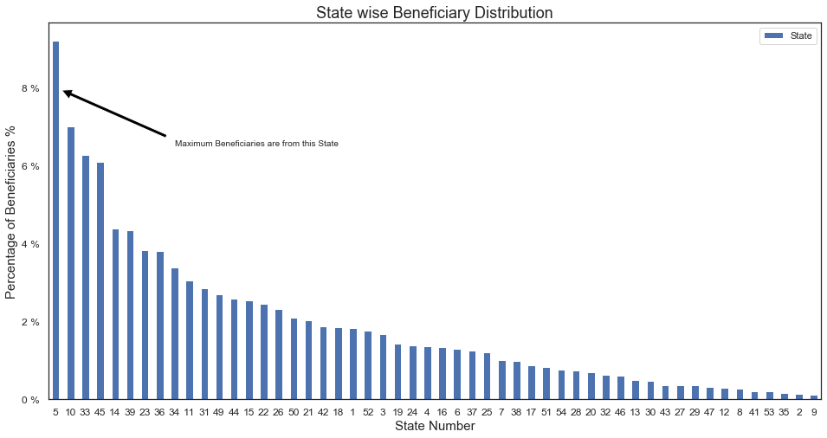
DISTRIBUTION OF FRAUD
59%
41%

Slide 11
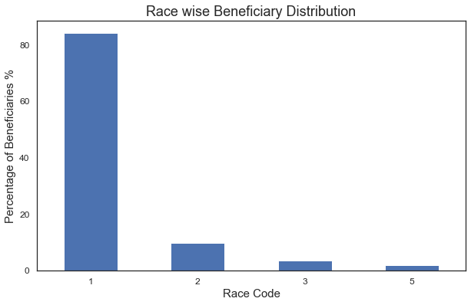
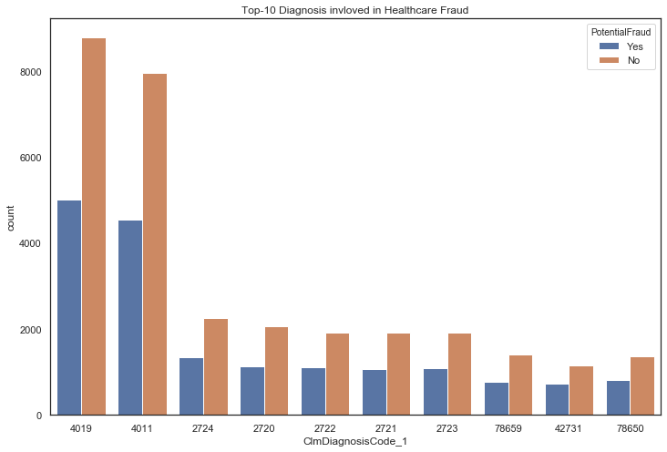
BENEFICIARIES AND RELATED DIAGNOSES

Slide 12
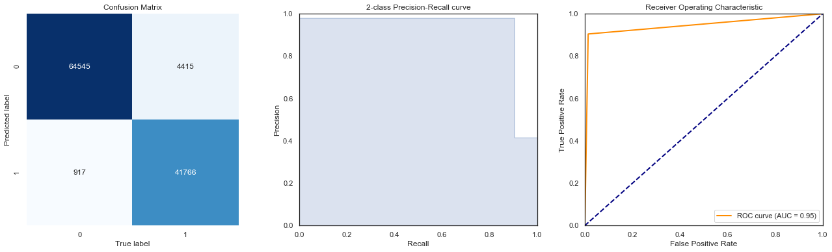
MODEL EVALUATION

Slide 13
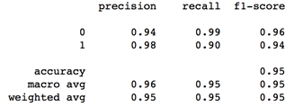
CLASSIFICATION REPORT

Slide 14
01
BUSINESS PROBLEM
02
DATA PROCESS
03
DELIVERY
04
NEXT STEPS & SUMMARY
AGENDA

Slide 15
*
Dockerize existing work
*
*
NEXT STEPS
Train with other classification algorithms
Deploy a FLASK API

Slide 16
$$
Avg insurance re-imbursements - $1400 AUD/Provider
$$
$$
BUSINESS VALUE & SUMMARY
Machine Learning can detect fraud with 95% accuracy
Savings – $ AUD 33 million per annum

Slide 17
*
Institute of Data
*
*
Class Mates ☺
*
Family & Friends ☺
ACKNOWLEDGEMENTS
UTS

Slide 18
*
Git - https://github.com/DSIA-Education/DSIA-SYD-FT-201909-Projects/tree/master/fakhrulislam/capstone
*
REFERENCES
Key URL’s
https://cloudblogs.microsoft.com/industry-blog/health/2017/03/14/the-most-common-types-of-healthcare-fraud/
http://www.roselladb.com/healthcare-fraud-detection.htm
https://www.mja.com.au/journal/2011/194/9/implementing-us-style-anti-fraud-laws-australian-pharmaceutical-and-health-care
http://heraldcorrespondent.com/healthcare-fraud-detection-market-is-booming-at-29-cagr-optum-cotiviti-mckesson-ibm.html
https://www.economist.com/united-states/2014/05/31/the-272-billion-swindle
https://www.kaggle.com/rohitrox/healthcare-provider-fraud-detection-analysis

Slide 19
*
Questions ?
*
*
islammdf@gmail.com
*
+61 402 231 822
THANK YOU!
LinkedIn - https://www.linkedin.com/in/md-fakhrul-islam/

